Slide 1
Embedded 2 – Cosy cafetaria Presentation
By Tobias Cromheecke, Thomas Feys, Robin Van de Poel, Arthur Van den Storme
13-5-2020

Slide 2
Index
Introduction
System architecture
Power management
Microcontroller
Sensor design
Housing design
Wi-Fi communication
Software design
Power consumption
Dashboard
Validation and testing
Demo

Slide 3
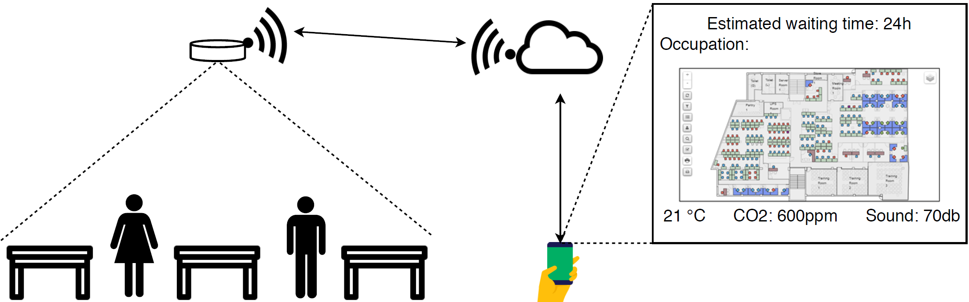
Introduction
Notes:
Volledige systeem eens bespreken zodat duidelijk is wat we willen bereiken

Slide 4
Specifications (only a few/most important)
Energy provision for 1 semester (4-5 months)
Must be rechargeable
Light weight: ~300 g
Measure new data every 10 minutes
Send the data website every hour (depending on changes in data)

Slide 5
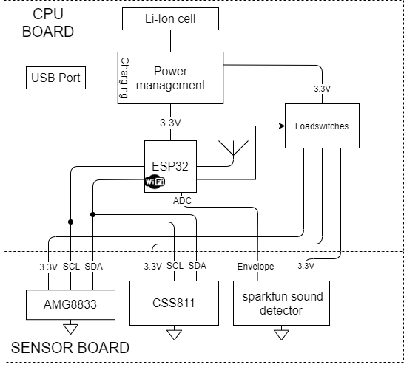
System architecture
Notes:
Overzicht van de hardware bespreken zodat het volledige beeld duidelijk is

Slide 6
Power management
Battery: Lithium-Ion battery
Protection IC
Charger IC via USB
Reverse polarity protection circtuit
LDO: 3,6 V to 3,3 V
Load switches to turn on/off the sensors
Availability to measure current

Slide 7
Microcontroller
Completed:
To do:
ESP32 single core
Design main pcb
Boot and reset button
Soldering
Testing
Designing revision

Slide 8
Sensor design
Completed:
PCB design of separate sensor board
Investigating response time of sensors
Bringing sensors
Functions: init, get data, sleep,…

Slide 9
Sensors
AMG8833:
IR grid sensor with a 8x8 pixel raster to measure the population of the students
ambient temperature
CSS811: air quality sensor:
CO2-level
Total Volatile Organic Compounds (TVOC)-level
Sparkfun sound detector: microphone

Slide 10
Problems/limitations
Limitations due to corona measures
Correct cooperation of sensor board with the main board.
Power measurements => break out boards sent to Thomas for functionality and power tests

Slide 11
Housing design
Completed:
To do:
Discussing a basic idea of the housing
Getting the measurements of all available part
A tutorial on 3D-printing design with fusion360
Design of housing
Checking if hardware fits the housing

Slide 12
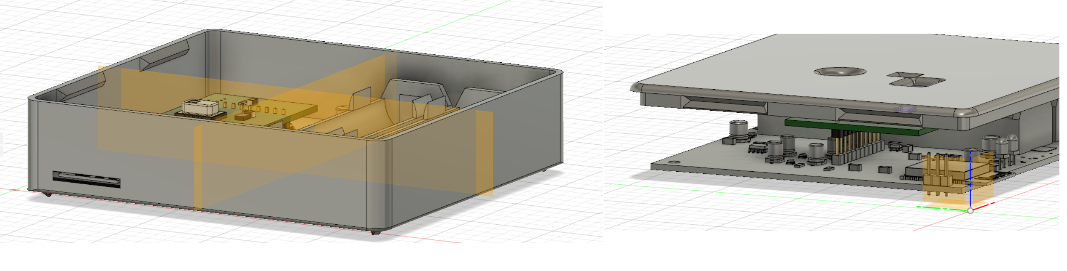
Problems/limitations
Delay on delivery housing
Due to corona pandemic
Fitting design housing not possible

Slide 13
Wi-Fi communication
TCP connection between ESP32 and Python server
Python server on Raspberry Pi
Server updates SQL database with received data

Slide 14
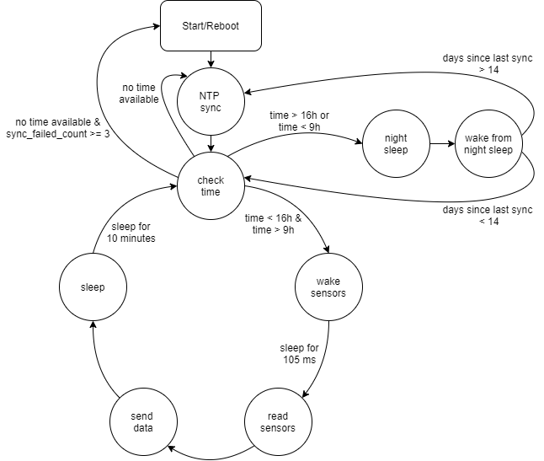
Software design
Functionality:
Pull sensors from sleep every 10 minutes and read sensor values
Send sensor data to Python server, over Wi-Fi
Perform periodic synchronisation to get time information
Use time information to disable power to sensors and put CPU in deepsleep during night (4 pm – 9 am)

Slide 15
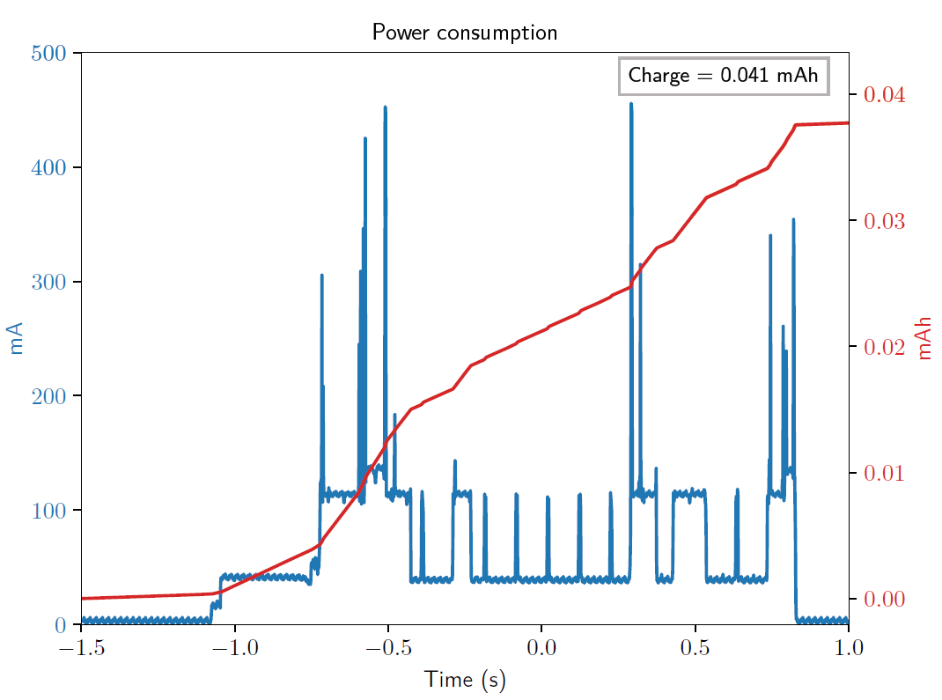
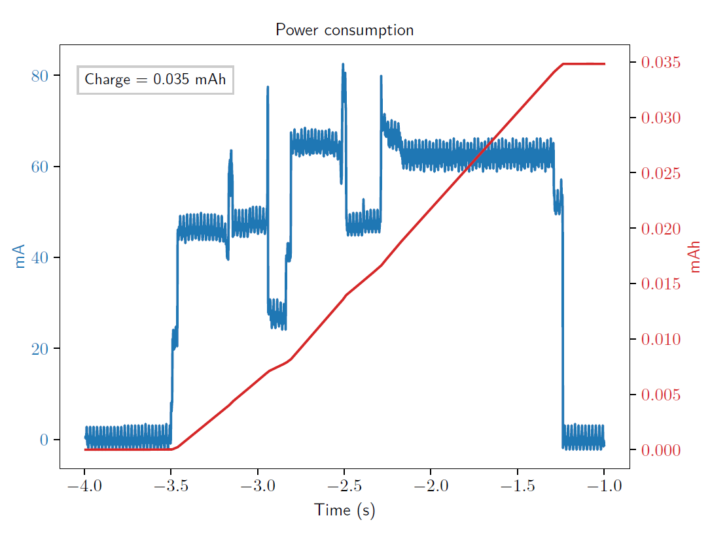
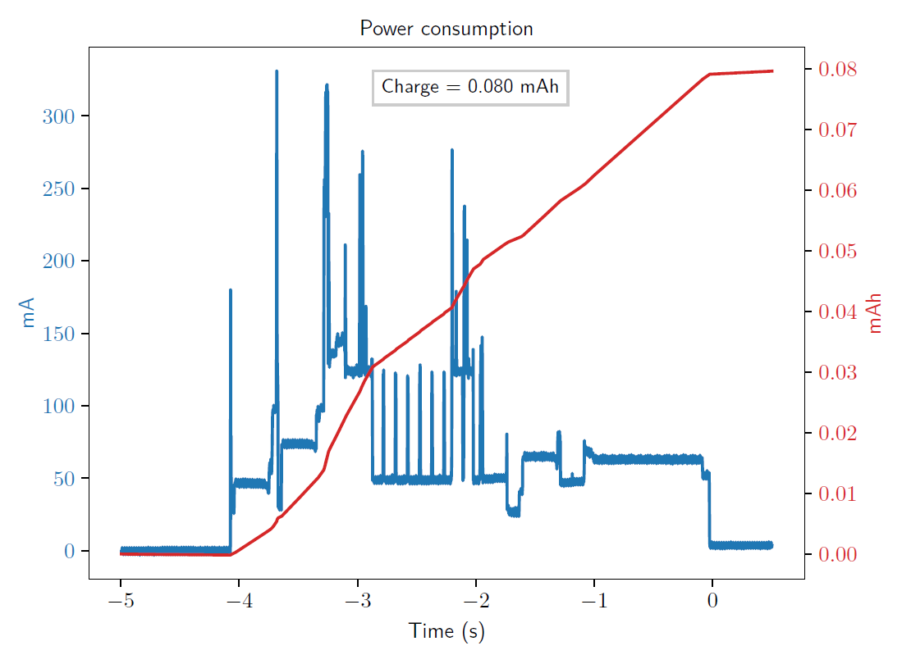
Power consumption
Consumption sources
Wi-Fi communication
Sensor measurement
NTP synchronisation
Standby consumption during daytime
Standby consumption during night-time

Slide 16
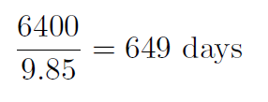
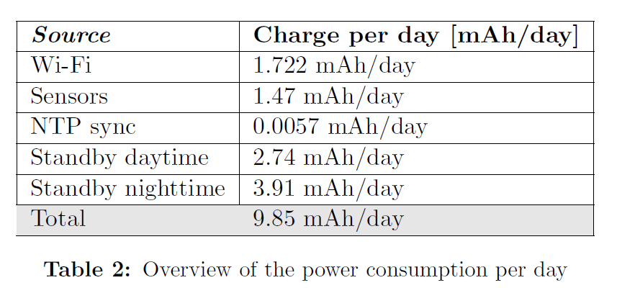
Power consumption
Power consumption per day:
Not taken into account:
9.85 mAh/day
=> Battery life =
Self discharge battery
quiescent current voltage regulator
quiescent current load switches

Slide 17
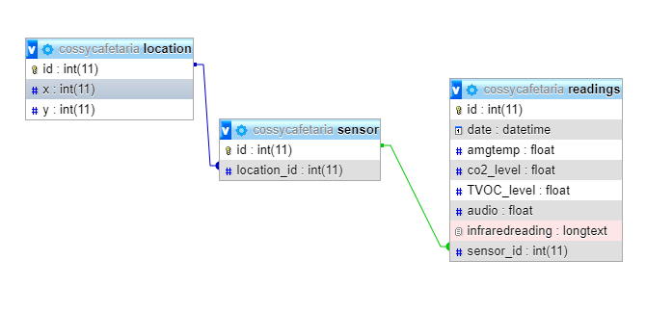
Dashboard
Backend
Raspberry Pi as server
Python script to recieve data
Mysql database
Apache2 webserver

Slide 18
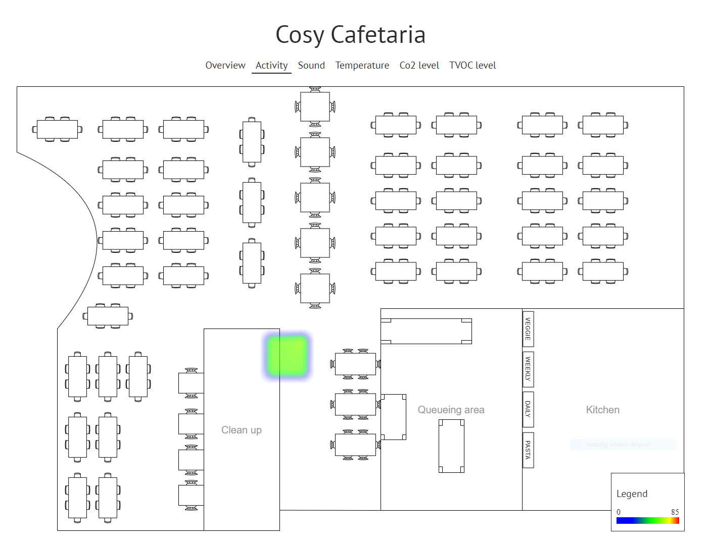
Dashboard
Frontend
Website
2 different types of pages
Overview
Heatmap

Slide 19
Validation and testing
Equipment:
ESP32-DEVKitC
AMG8833 break-out board
CCS811 break-out board
Raspberry Pi to host the server, database and website

Slide 20
Validation and testing
Successfully validated:
To validate:
Software
AMG8833
CCS811
Hardware: power management, load switches, sensor board, ESP32 board
=> Software is fully functional
Notes:
The correct functionality of the software has been tested by uploading the code in the development kit.
The sensor data of the ir sensor and the airquality sensor was succesfully updated every ten minutes.
Then the sensor data was succesfully transmitted to the server that was running on the raspberry pi, the values in the sql
Database were succesfully updated.
The only sensor that couldnt be tested is the microphone, because no break-out board was availible. However, the microphone produces an analog signal that
Has to be captured with the adc of the esp32 this was tested by connecting an analog ouput of the esp32 to the adc.
Next to the sensors and the datatransfer, the system was tested for 1 full day to verify the timing that is used. The system could perform the ntp synchronisation
Succesfully and went to deepsleep once it was past 4 pm

Slide 21
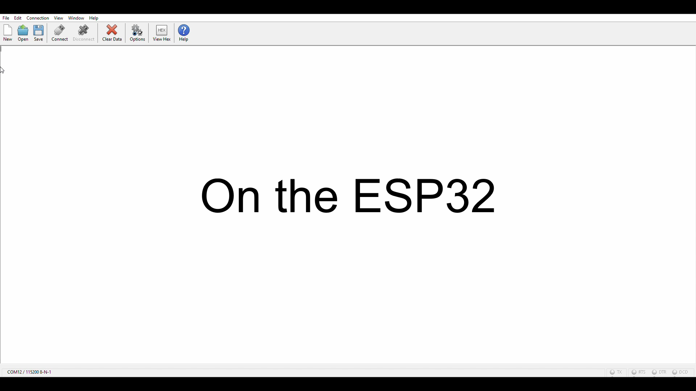
Demo

Slide 22
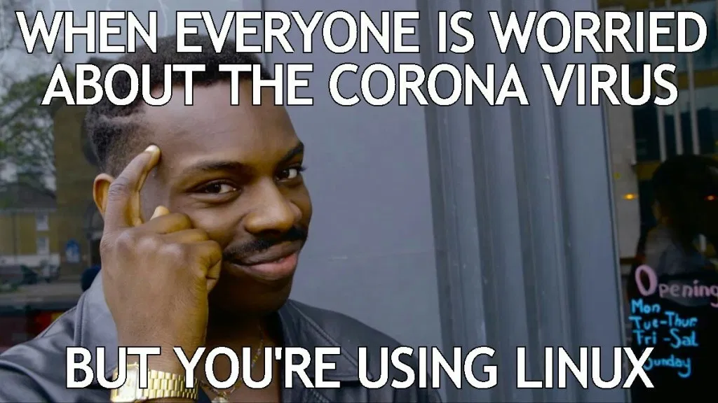
Conclusion
Despite corona fully functional end product
Final test on developed hardware necessary
Notes:
Fully functional end product that was tested on devkits and break-out boards

